Slide 1
Introduction to Artificial Intelligence and Machine Learning: Fundamentals and Applications
Exploring AI and ML technologies and their impact
Speaker : Nikhil Shah
Notes:
--- Artificial Intelligence (AI) and Machine Learning (ML) are transformative technologies that are reshaping various industries. In this presentation, we will explore the foundational concepts of AI and ML, their algorithms, key components, and real-world applications.

Slide 2
Agenda Overview
Understanding Artificial Intelligence (AI)
Overview of Machine Learning (ML)
Fundamental Algorithms in Machine Learning
Key Components and Technologies in AI and ML
Applications and Impact of AI and ML
Notes:
We will begin by understanding what artificial intelligence is, including its definition, history, and different types. Following that, we will discuss machine learning, its relationship to AI, and its various types. We will delve into fundamental algorithms used in ML, key components and technologies, and finally, the applications and impacts of AI and ML in different sectors.

Slide 3
Understanding Artificial Intelligence (AI)
Notes:
AI is a rapidly evolving field with a significant impact on society. It encompasses a range of technologies that enable machines to perform tasks that typically require human intelligence.

Slide 4
Definition and History of AI
What is AI?
AI refers to the simulation of human intelligence by machines, enabling them to perform tasks that typically require human intellect.
Historical Milestones
The journey of AI began in the mid-20th century, marked by significant developments and breakthroughs in technology and theoretical foundations.
Modern Applications
Recent advancements in AI have led to diverse applications, from virtual assistants to advanced machine learning systems that impact everyday life.
Notes:
Artificial Intelligence is defined as the simulation of human intelligence processes by machines. The journey of AI dates back to the mid-20th century, with significant breakthroughs occurring in the last few decades, leading to modern AI applications.

Slide 5
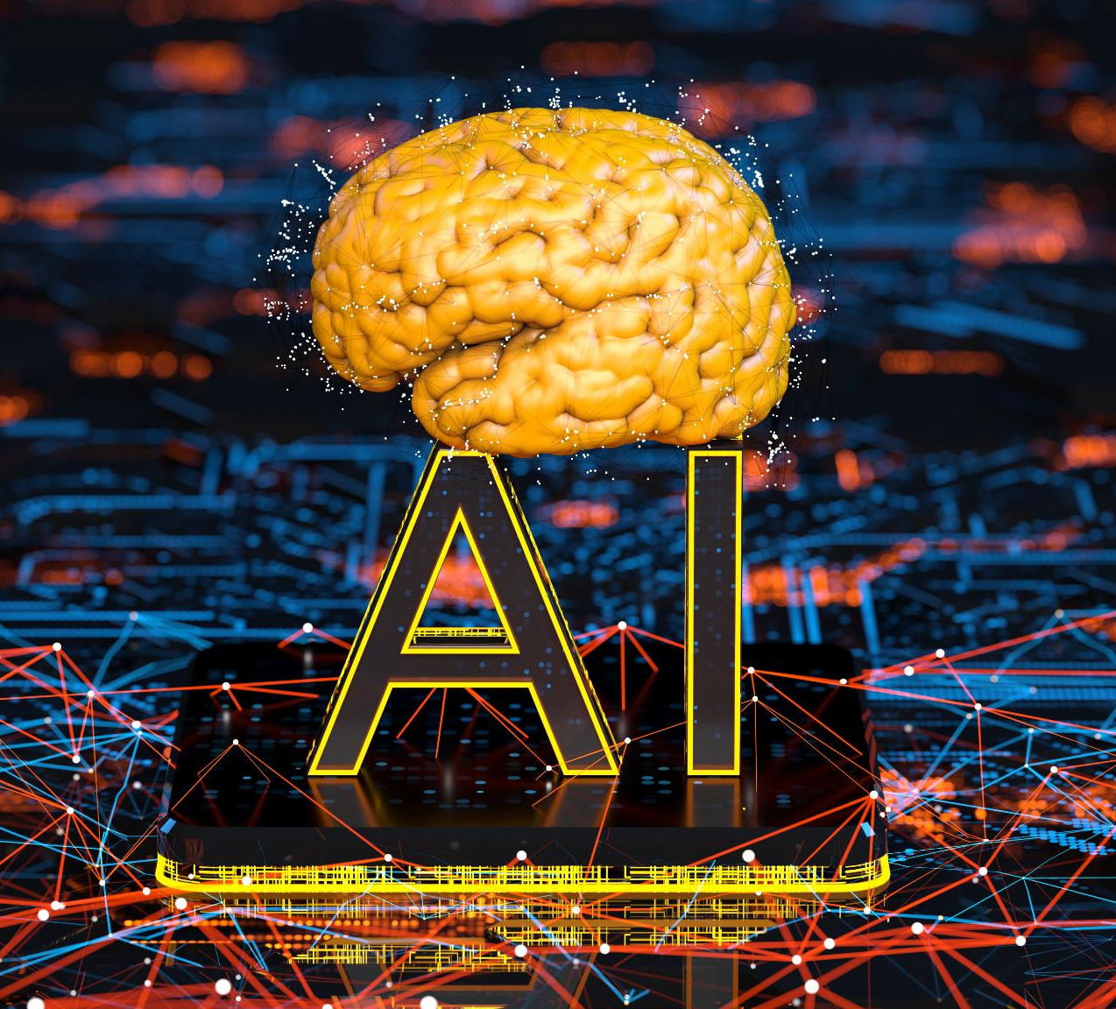
Types of AI (Narrow AI, General AI, Superintelligent AI)
Narrow AI
Narrow AI is designed to perform specific tasks effectively, like voice assistants or recommendation systems.
General AI
General AI possesses the capability to perform any intellectual task that a human can do, allowing for a wide range of applications.
Superintelligent AI
Superintelligent AI exceeds human intelligence in every aspect, potentially revolutionizing problem-solving and decision-making.
Notes:
AI can be categorized into three main types: Narrow AI, which is designed for specific tasks; General AI, which can perform any intellectual task like a human; and Superintelligent AI, which surpasses human intelligence in all aspects.

Slide 6
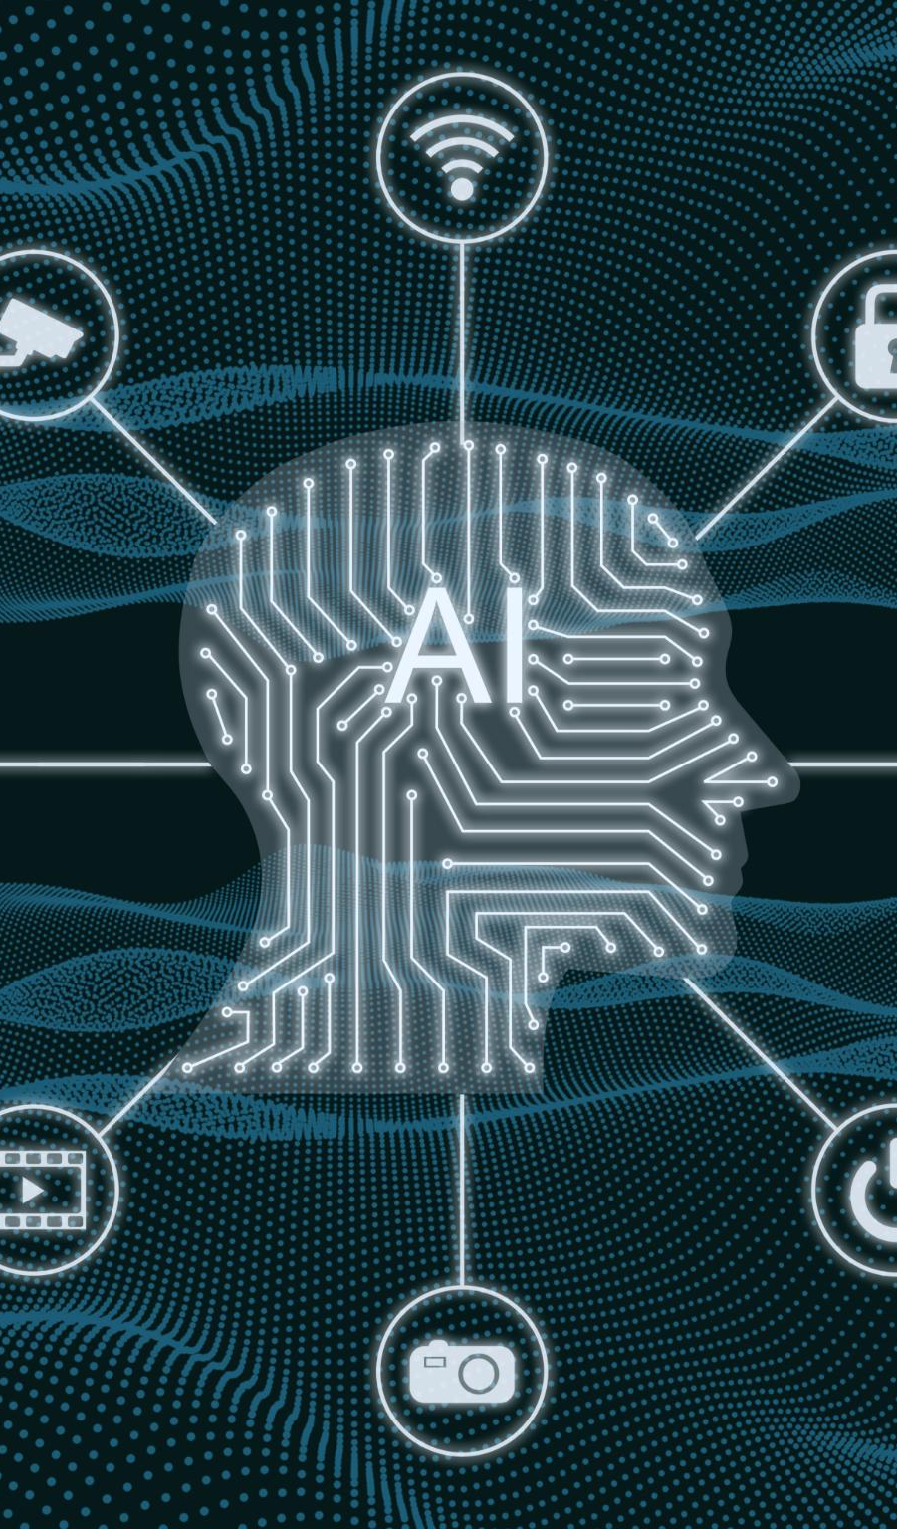
Key Concepts in AI
Machine Learning
Machine learning is a subset of AI that enables systems to learn and make predictions based on data.
Neural Networks
Neural networks are computational models inspired by the human brain, used for recognizing patterns and processing complex data.
Natural Language Processing
Natural language processing (NLP) allows machines to understand and interpret human languages, facilitating human-computer interaction.
Robotics
Robotics involves the design and use of robots to perform tasks, often integrated with AI to enhance their capabilities.
Notes:
Key concepts in AI include machine learning, neural networks, natural language processing, and robotics. Understanding these concepts is crucial for grasping how AI systems function and are developed.

Slide 7
Overview of Machine Learning (ML)
Notes:
Machine Learning is a subset of AI that focuses on the development of algorithms that allow computers to learn from and make predictions based on data.

Slide 8
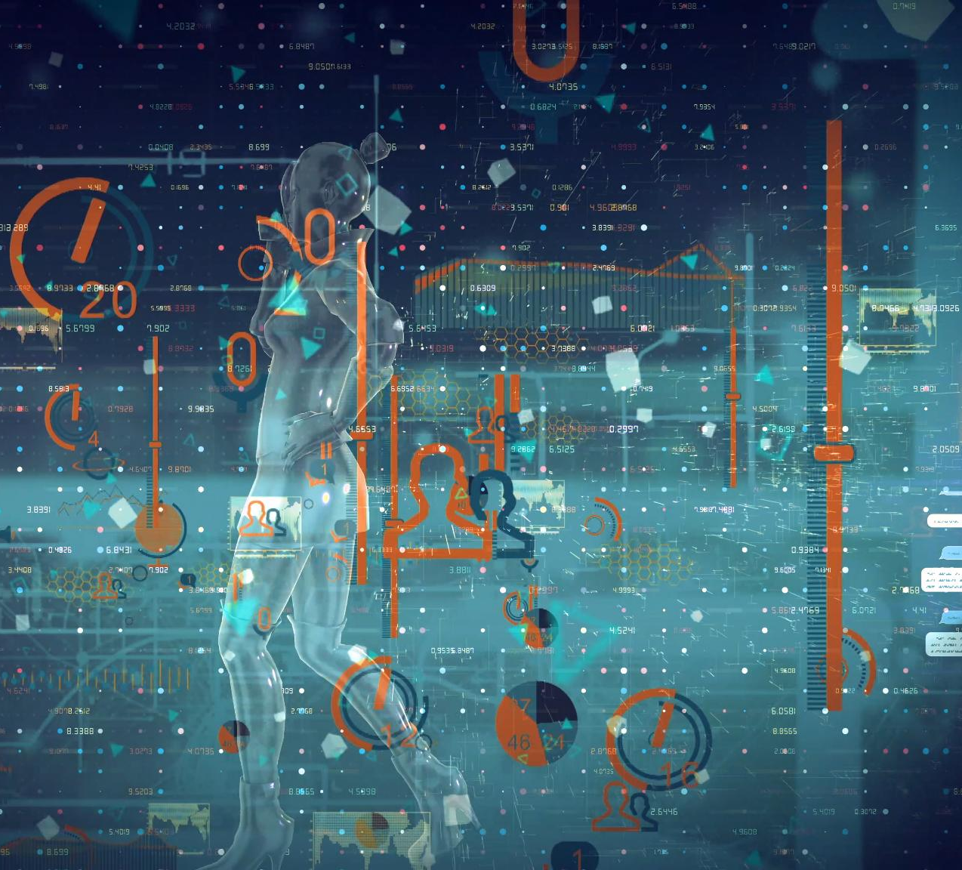
Definition and Relationship to AI
Understanding Machine Learning
Machine Learning involves algorithms that allow computers to learn from data without explicit programming, enhancing their task performance.
Role in Artificial Intelligence
Machine Learning is a crucial part of AI, providing systems with the capability to adapt and improve over time based on new data.
Notes:
Machine Learning refers to the methods by which computers learn from data to improve their performance on specific tasks. It is an essential component of AI, as it enables systems to adapt and evolve over time.

Slide 9
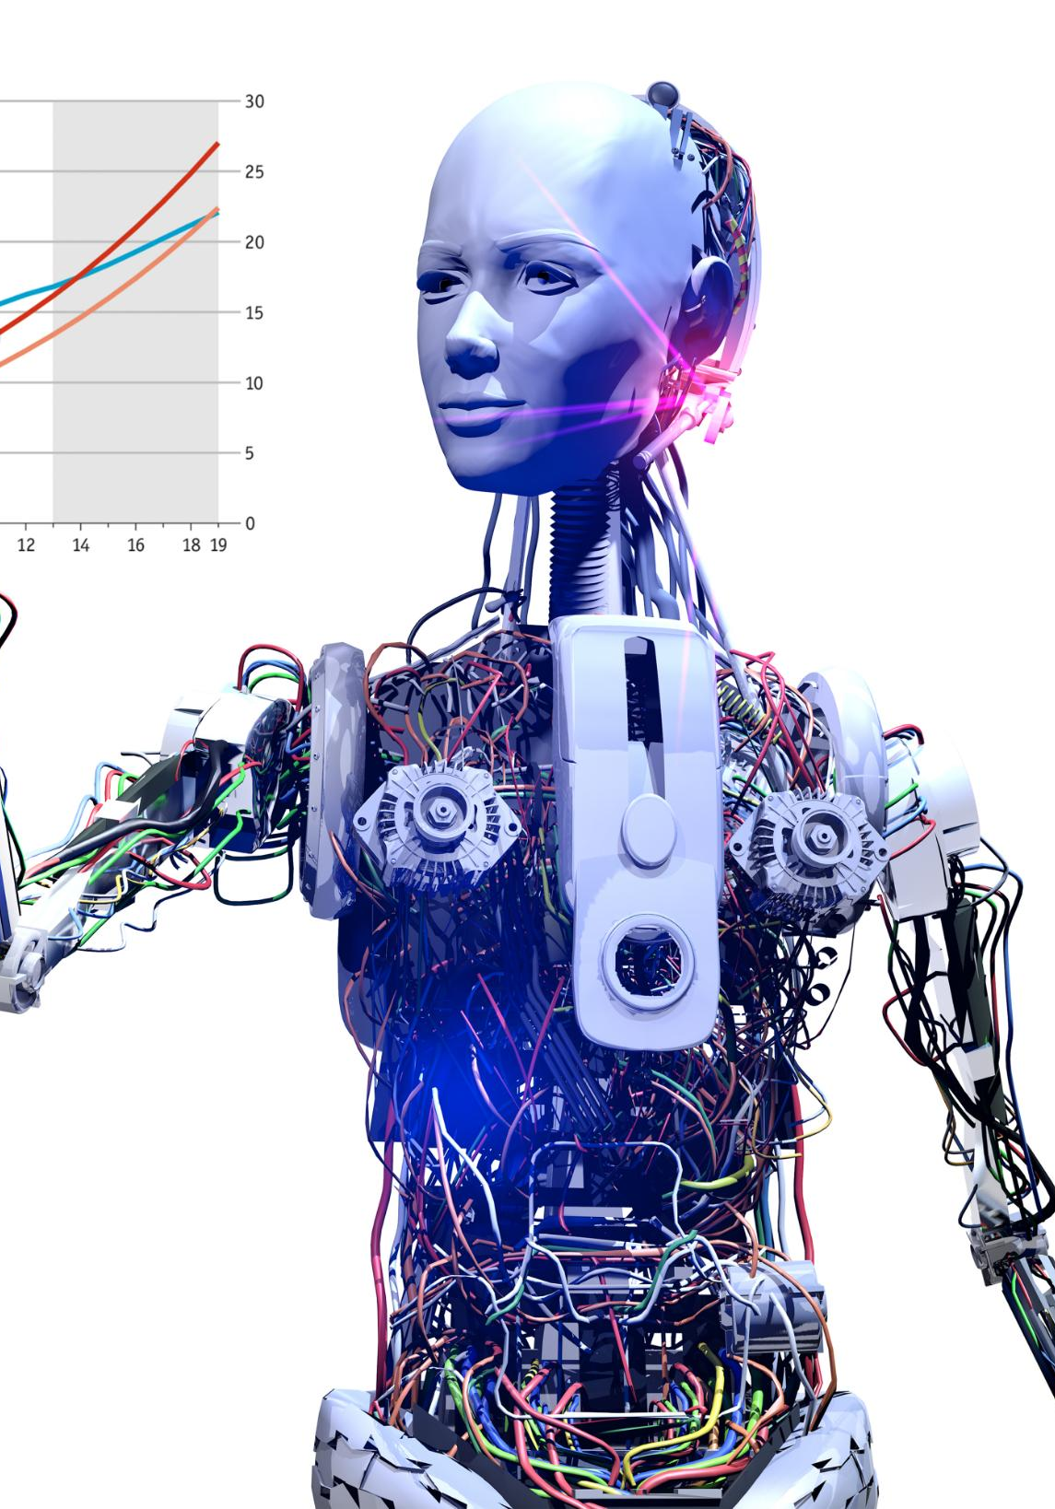
Brief History of Machine Learning
Early Algorithms
The journey of machine learning began in the 1950s with the development of early algorithms that laid the foundation for future advancements.
Growth of ML
Over the decades, machine learning has experienced significant growth, evolving with technological advancements and increasing data availability.
Deep Learning Revolution
The 2010s marked the explosion of deep learning, a subset of machine learning that led to breakthroughs in various fields, including image and speech recognition.
Notes:
The history of machine learning is marked by key milestones, from early algorithms in the 1950s to the explosion of deep learning in the 2010s. This history highlights the rapid advancements and growing importance of ML.

Slide 10
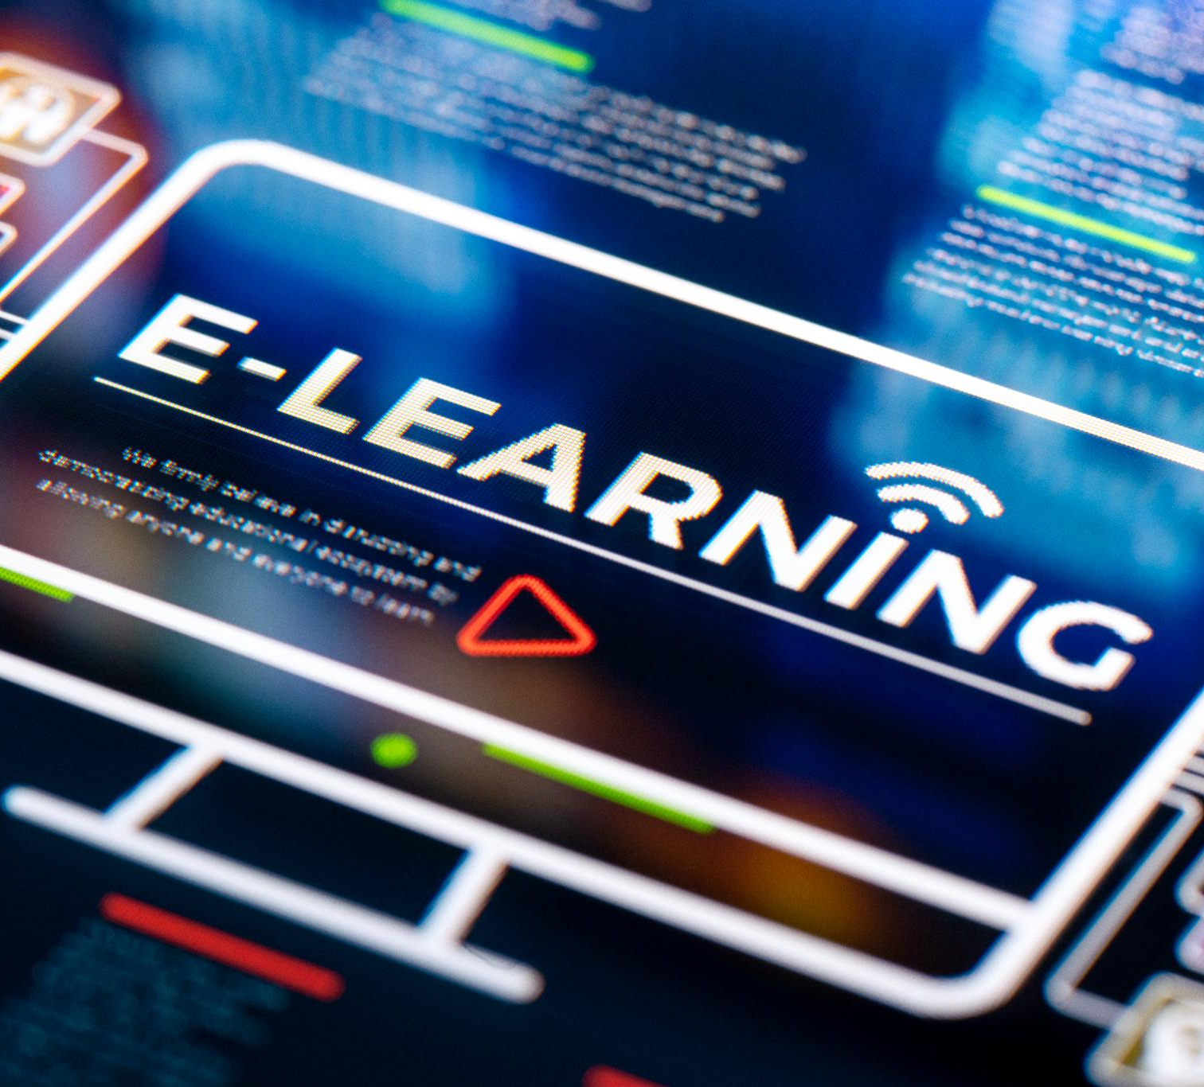
Types of Machine Learning (Supervised, Unsupervised, Reinforcement Learning)
Supervised Learning
Supervised Learning uses labeled data to train algorithms for predicting outcomes based on input data.
Unsupervised Learning
Unsupervised Learning analyzes unlabeled data to discover patterns and groupings without prior training.
Reinforcement Learning
Reinforcement Learning trains models through trial and error, optimizing actions based on rewards and penalties.
Notes:
Machine Learning can be categorized into three main types: Supervised Learning, which uses labeled data; Unsupervised Learning, which finds patterns in unlabeled data; and Reinforcement Learning, which learns through trial and error.

Slide 11
Fundamental Algorithms in Machine Learning
Notes:
Understanding key algorithms in machine learning is vital for implementing effective models. Different algorithms are suited for different tasks and data types.

Slide 12
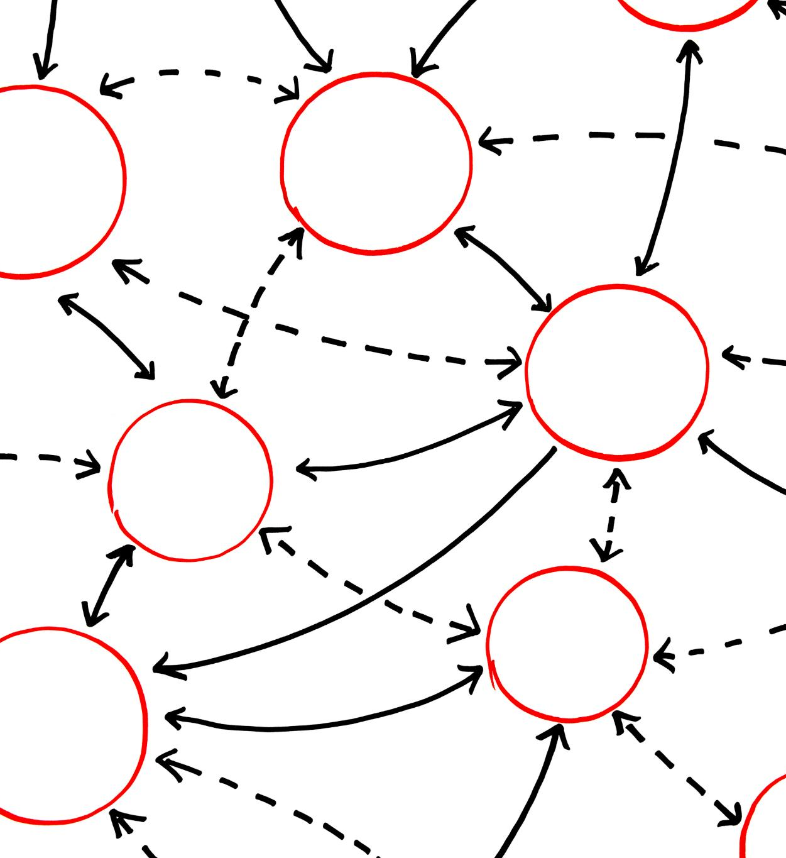
Supervised Learning Algorithms (Linear Regression, Decision Trees, Etc.)
Understanding Supervised Learning
Supervised learning involves using labeled datasets to train algorithms, enabling them to make predictions on unseen data.
Linear Regression
Linear Regression is a statistical method used for predicting outcomes based on the relationship between variables.
Decision Trees
Decision Trees are a popular supervised learning method used for classification tasks, creating a model that predicts outcomes based on input features.
Notes:
Supervised learning algorithms, such as Linear Regression and Decision Trees, use labeled data to predict outcomes. They are widely used for classification and regression tasks.

Slide 13
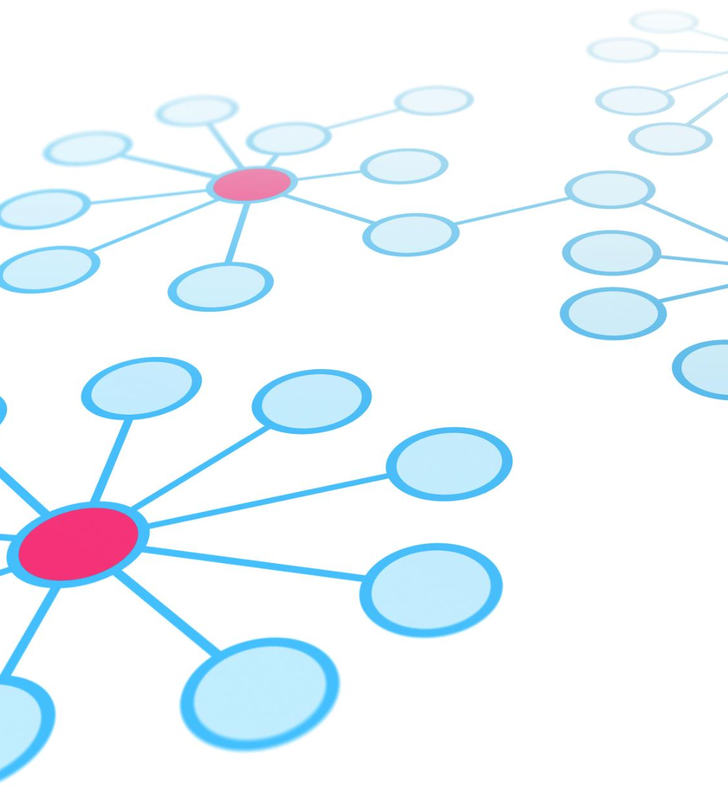
Unsupervised Learning Algorithms (K-Means Clustering, PCA, Etc.)
K-Means Clustering
K-Means Clustering is an algorithm that groups data into distinct clusters based on similarity without prior labels.
Principal Component Analysis (PCA)
PCA is a technique used to reduce the dimensionality of data while preserving important features, revealing underlying structures.
Patterns and Structures
Unsupervised learning uncovers hidden patterns and structures in datasets, providing insights for further analysis.
Notes:
Unsupervised learning algorithms, like K-Means Clustering and Principal Component Analysis (PCA), analyze and group data without prior labels, revealing hidden patterns and structures.

Slide 14
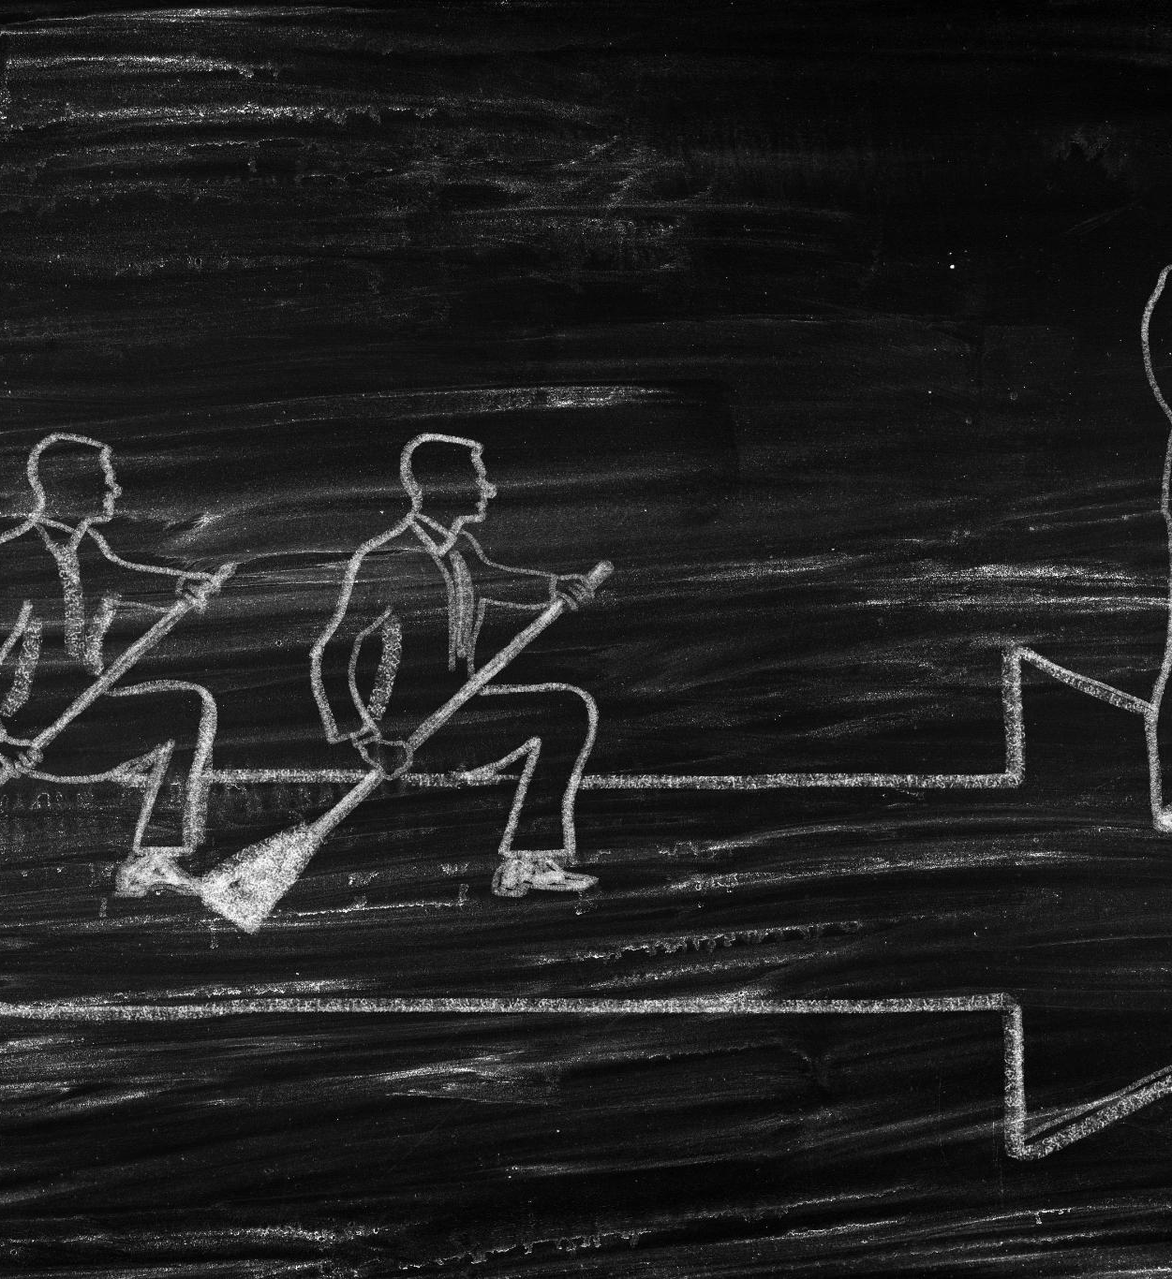
Reinforcement Learning Algorithms (Q-Learning, Deep Q-Networks, Etc.)
Understanding Reinforcement Learning
Reinforcement Learning involves training agents by providing rewards or penalties based on their actions, shaping their learning process.
Q-Learning Algorithm
Q-Learning is a model-free reinforcement learning algorithm that enables agents to learn optimal action-selection policies.
Deep Q-Networks
Deep Q-Networks combine Q-Learning with deep neural networks to handle high-dimensional state spaces for complex decision-making tasks.
Notes:
Reinforcement Learning focuses on training agents through rewards and penalties. Algorithms like Q-Learning and Deep Q-Networks enable agents to learn optimal strategies for decision-making.

Slide 15
Key Components and Technologies in AI and ML
Notes:
AI and ML rely on several key components and technologies that enable data processing, model training, and deployment of intelligent systems.

Slide 16

Data and Data Preprocessing
Importance of Quality Data
Quality data is essential for the effectiveness of AI and ML models, directly impacting their performance.
Data Preprocessing Steps
Data preprocessing includes various steps such as cleaning, transforming, and organizing data for analysis.
Effectiveness of Models
Without proper data preprocessing, AI and ML models cannot produce reliable outcomes and insights.
Notes:
Data is the foundation of AI and ML; without quality data, models cannot perform effectively. Data preprocessing involves cleaning and organizing data to make it suitable for analysis.

Slide 17

Neural Networks and Deep Learning
AI and Neural Networks
Neural Networks simulate human brain function to process complex data. They are instrumental in the field of artificial intelligence.
Deep Learning Advancements
Deep Learning utilizes multi-layered neural networks to achieve breakthroughs in various fields, including image and speech recognition.
Image and Speech Recognition
Significant advancements in image and speech recognition have been made possible through the use of Deep Learning techniques.
Notes:
Neural Networks are a key technology in AI, simulating the way the human brain operates to process information. Deep Learning, which uses multi-layered neural networks, has led to significant advancements in image and speech recognition.

Slide 18

Natural Language Processing (NLP)
Understanding Human Language
Natural Language Processing allows machines to effectively understand and interpret human language in a meaningful way.
Chatbots and Virtual Assistants
NLP is essential for developing chatbots and virtual assistants that can engage users in conversation and provide assistance.
Translation Services
NLP technologies power translation services, enabling accurate and efficient conversion of text between languages.
Sentiment Analysis
NLP facilitates sentiment analysis, allowing businesses to gauge public opinion and customer feedback on products and services.
Notes:
Natural Language Processing enables machines to understand and interpret human language. NLP is crucial for applications like chatbots, translation services, and sentiment analysis.

Slide 19
Applications and Impact of AI and ML
Notes:
AI and ML have transformative impacts across various fields, enhancing capabilities and efficiency in sectors such as healthcare, finance, and beyond.

Slide 20

AI and ML in Healthcare
Revolutionizing Diagnostics
AI and ML technologies are transforming diagnostics by enhancing the accuracy and speed of medical evaluations.
Personalized Medicine
These technologies enable personalized medicine by tailoring treatment plans to individual patient needs based on their unique data.
Patient Care Management
AI and ML improve patient care management, ensuring better communication and monitoring of patient health over time.
Notes:
In healthcare, AI and ML are revolutionizing diagnostics, personalized medicine, and patient care management, leading to improved outcomes and efficiency in the healthcare system.

Slide 21

AI and ML in Finance
Fraud Detection
AI and ML algorithms are utilized to detect fraudulent activities in real-time, ensuring the security of financial transactions.
Algorithmic Trading
Algorithmic trading leverages AI and ML to analyze market data and execute trades at optimal times, maximizing profits.
Risk Assessment
AI and ML help in assessing financial risks by analyzing historical data and predicting future trends, aiding in better decision-making.
Notes:
In the finance sector, AI and ML are used for fraud detection, algorithmic trading, and risk assessment, enabling faster and more accurate decision-making.

Slide 22
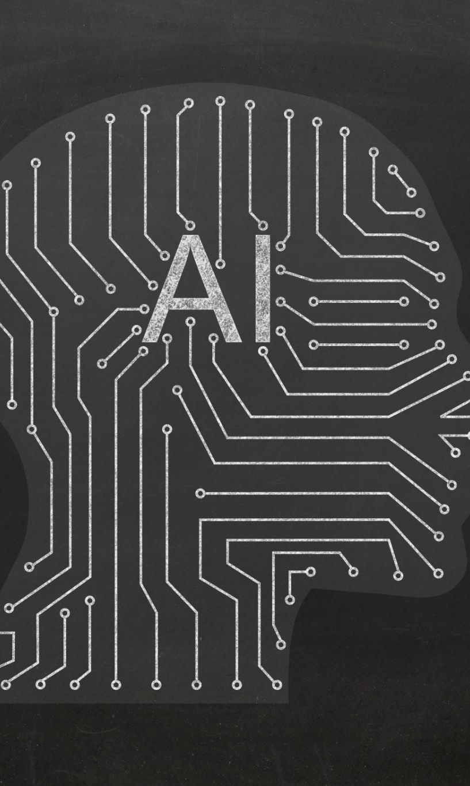
Future Trends and Ethical Considerations
Ethical Implications
The rapid advancement of AI and ML raises important ethical questions that need to be addressed proactively.
Bias in Algorithms
Bias in algorithms can lead to unfair outcomes, demanding a careful examination of data and model training.
Job Displacement
AI and ML have the potential to displace jobs, necessitating discussions on workforce transition and retraining.
Data Privacy
Data privacy concerns arise as AI systems process vast amounts of personal information, requiring robust safeguards.
Notes:
As AI and ML continue to advance, it is vital to consider ethical implications, including bias in algorithms, job displacement, and data privacy. Addressing these concerns will shape the future of AI and ML.

Slide 23
Conclusion
Pivotal Role in Innovation
AI and Machine Learning drive technological advancements and innovation, transforming industries such as healthcare, finance, and transportation.
Fundamentals of AI and ML
Understanding the basics of AI and Machine Learning is essential for leveraging these technologies effectively in practice.
Ethical Implications
As AI and Machine Learning evolve, addressing ethical implications and ensuring responsible use of technology is crucial for society.
Notes:
Artificial Intelligence and Machine Learning are pivotal to technological advancement and innovation across industries. Understanding their fundamentals, applications, and ethical implications is essential as we move toward a future shaped by these technologies.

Slide 24
Thanks and REgards
Nikhil Shah
nikhilshah.net@hotmail.com
8975089722

